Slide 1

Computer Graphics
CS C 471 and IS C 471
Dr. Lucy J. Gudino
Computer Science & Information Systems Group
Birla Institute of Technology & Science, Pilani, Goa Campus
1

Slide 2
Types of computer graphics
Simple or passive computer graphics
Control – No control
Communication – one way communication
Interaction – No Interaction between user and H/W
Motion and updation – not supported
Interactive or Active computer graphics
Communicating with the graphics packages during creation and manipulation of images and pictures
Control – Dynamic nature
Communication – two way communication
Motion and updation – 2-D, 3-D transformations

Slide 3
Important Terms
Imaging
Representing 2D images
Modeling
Representing 3D objects
Rendering
Constructing 2D images from 3D models
Animation
Simulating changes over time

Slide 4
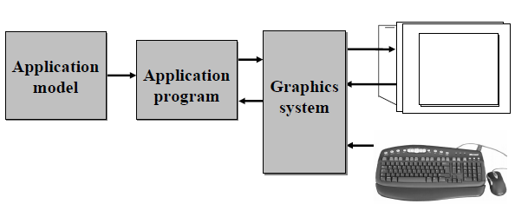
Conceptual framework for interactive Graphics

Slide 5
Conceptual framework for interactive Graphics
3 software components
Application model : modeling of data or objects to be displayed on the screen
Application program: Application program maps application objects to views (images) of those objects by calling on graphics library.
User interaction results in modification of model and/or image
Graphics system : responsible for actually producing the picture

Slide 6
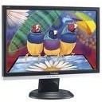

Contd..
Data Model
of what you want to draw
Application Software
to interact with the model
Graphics Library software
Which drives
Calls
The graphics hardware
Sending image to the display unit
Input device which signals the software to change something
Which the user sees and produces actions that controls

Slide 7
Applications
Notes:
Applications of Computer Graphics
1. User interfaces: It is now a well established fact that graphical interfaces provide an
attractive and easy interaction between users and computers. The built-in graphics
provided with user interfaces use visual control items such as buttons, menus, icons,
scroll bar etc, which allows user to interact with computer only by mouse-click.
Typing is necessary only to input text to be stored and manipulated.
2. Plotting of graphics and chart: In industry, business, government, and educational
organizations, computer graphics is most commonly used to create 2D and 3D
graphs of mathematical, physical and economic functions in form of histograms, bars
and pie-charts. These graphs and charts are very useful for decision making.
3. Computer-aided drafting and design: the computer –aided drafting uses graphics to
design components and systems electrical, mechanical, electromechanical and electronic
devices such as automobile bodies, structures of building, airplane, ships,
very large scale integrated chips, optical systems and computer networks.
4. Simulation and Animation: use of graphics in simulation makes mathematic models
and mechanical systems more realistic and easy to study. The interactive graphics
supported by animation software proved their use in production of animated movies
and cartoons films.
5. Art and Commerce: There is a lot of development in the tools provided by computer
graphics. This allows user to create artistic pictures which express message and
attract attentions. Such pictures are very useful in advertising.
6. Process Control: By the use of computer now it is possible to control various
processes in the industry from a remote control room. In such cases, process
systems and processing parameters are shown on the computer with graphic
symbols and identifications. This makes it easy for operator to monitor and control
various processing parameters at a time.
7. Cartography: Computer graphics is also used to represent geographic maps, weather
maps, oceanographic charts, counter maps, population density maps and so on.
8. Education and training: computer graphics can be used to generate models of
physical aids. Models of physical systems, physiological systems, population trends,
or equipment, such as color –coded diagram can help trainees to understand the
operation of the system.
9. Image processing: in computer graphics, a computer is used to create pictures.
Image processing, on the other hands, applies techniques to modify or interpret
existing picture such as photographs and scanned image. Image processing and
computer graphics are typically combined in many applications such as to model and
study physical functions, to design artificial limbs, and to plan and practice surgery.
Image processing techniques are most commonly used for picture enhancements to
analyze satellite photos, X-ray photography and so on.

Slide 8

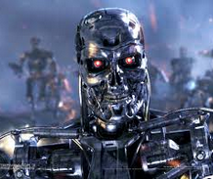
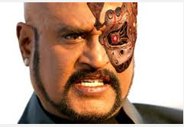



Entertainment
1992 : Michel Jackson’s music album “Black and White” used Morphing technique
Special effects using computer graphics
Little Stuart in late 1990

Slide 9
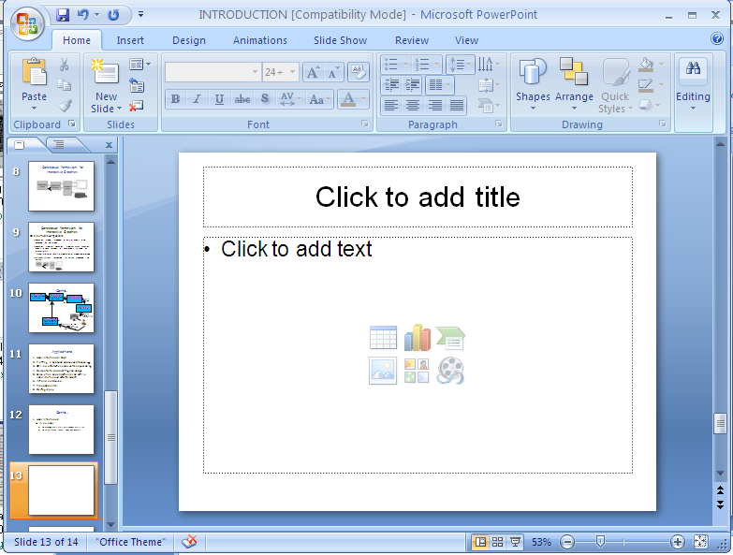
User interfaces - GUI
Allow user
To manage multiple simultaneous activities
To select menu items, icons and objects
Typical components
Menus
Icons
Cursors
Dialog boxes
Scroll Bars
Buttons
Grids
Sketching
3D interface

Slide 10
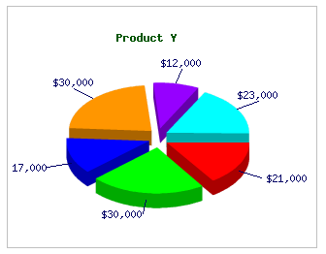
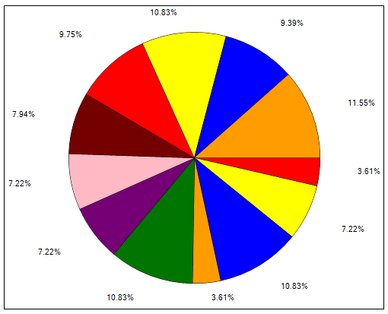
Contd…
Plotting in business, science and technology
2D and 3D graphs of mathematical, physical and economic functions
Pie chart

Slide 11
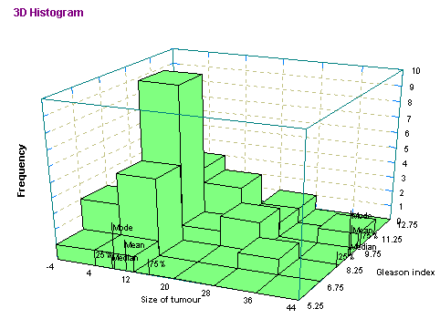
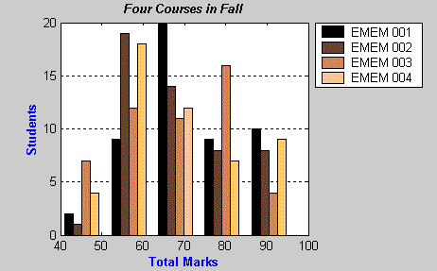
Contd…
Histogram

Slide 12
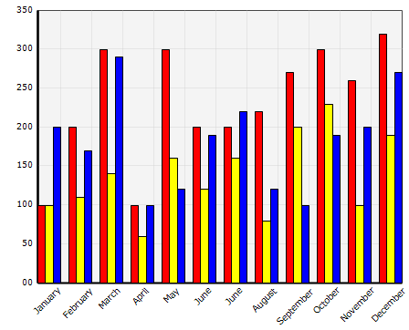
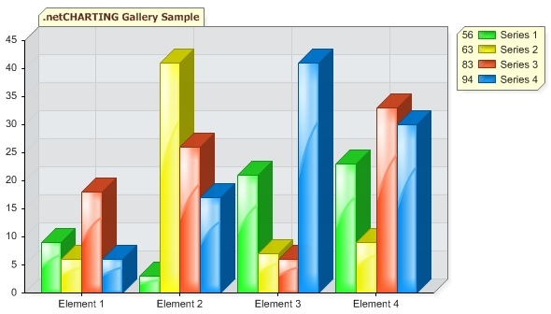
Contd…
Bar Chart

Slide 13
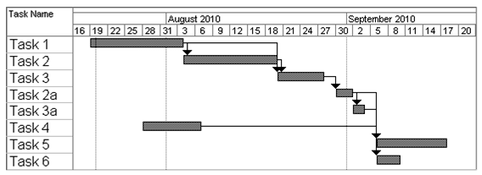
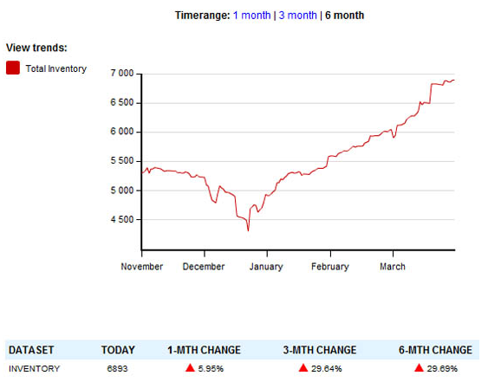
Task scheduling charts
Inventory charts

Slide 14

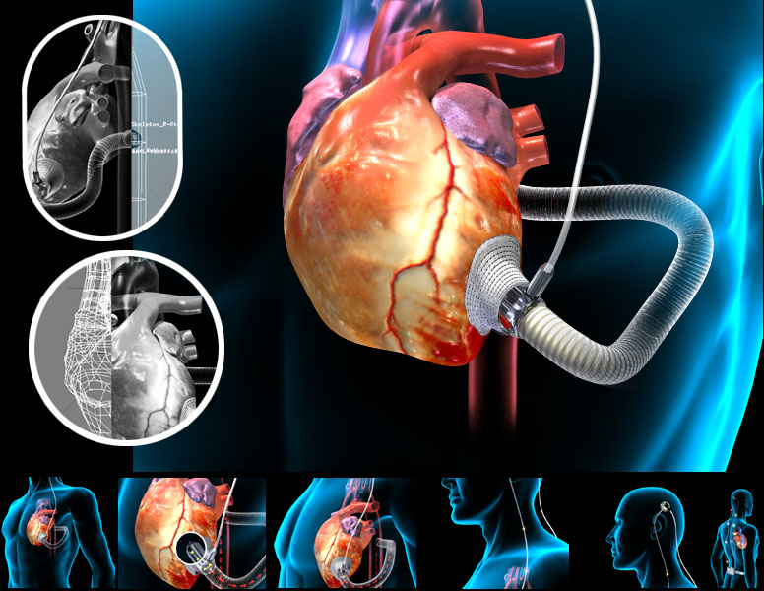
Display of scientific and medical data
Nebula
Medical Image
Notes:
Nebula : cloud of gas and dust

Slide 15
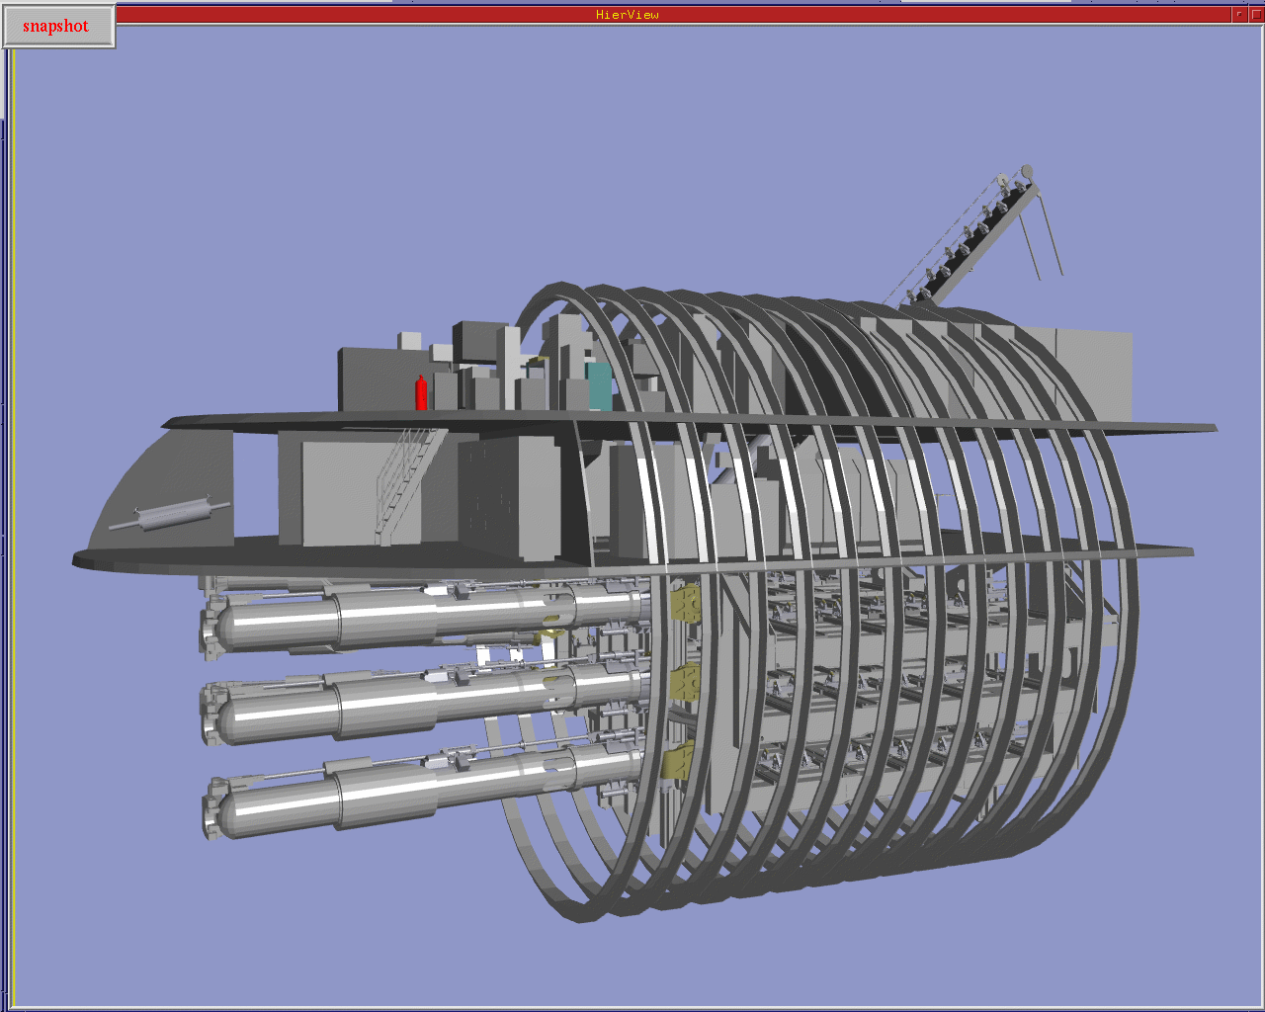
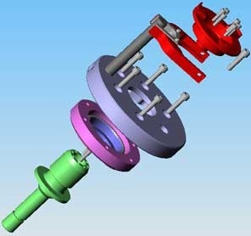
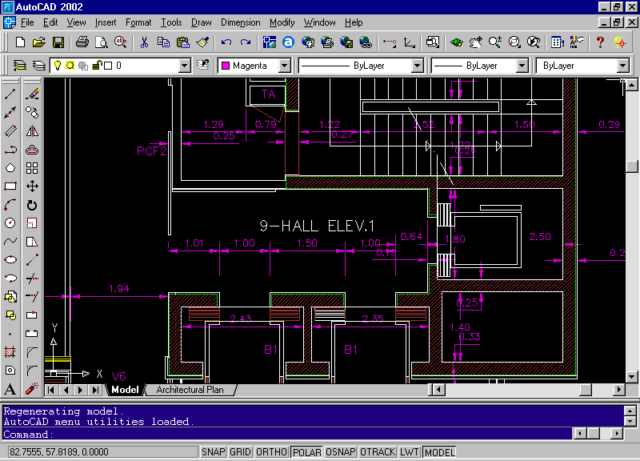

Computer-aided drafting (CAD) and Computer Aided Manufacturing (CAM) design – VLSI, Construction, circuits design
Interior Design
AutoCAD 2002

Slide 16
Office automation
Microsoft office
Excel
Power point
Electronic Publishing or desktop publishing
Designing documents

Slide 17
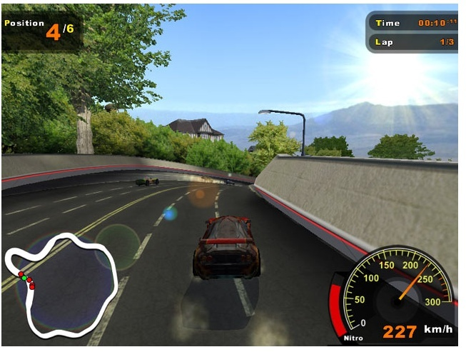
Computer Games:

Slide 18

Web/business/commercial publishing and advertisements

Slide 19
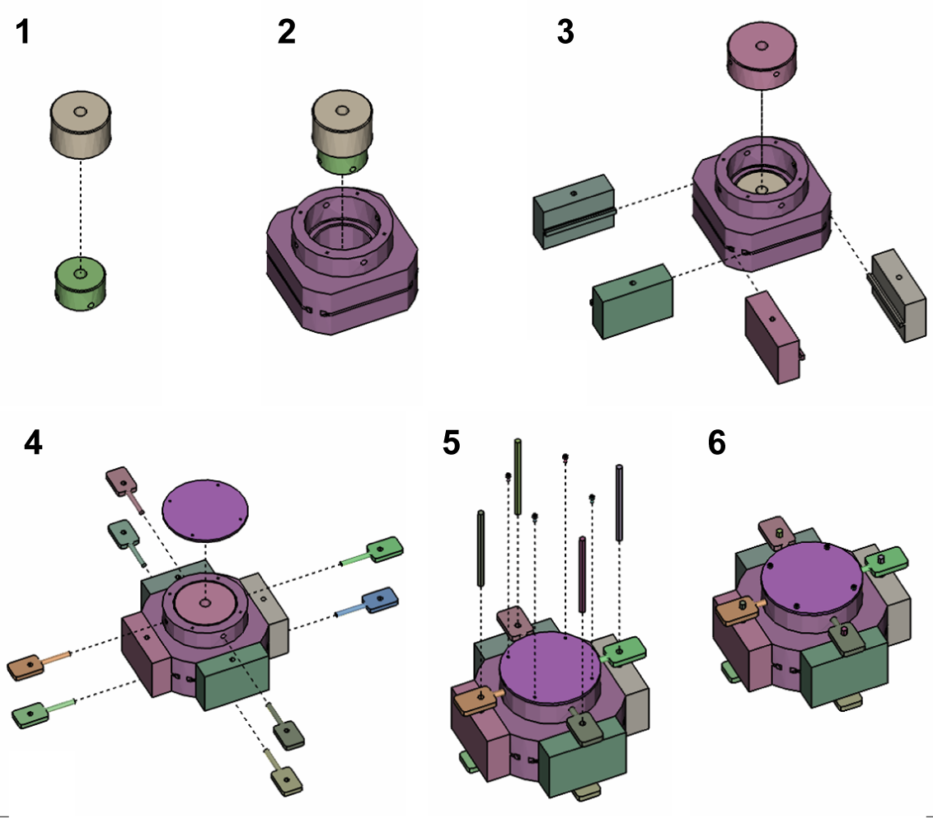
Education and Training
Designing Effective Step-By-Step Assembly Instructions (Maneesh Agrawala et. al)

Slide 20
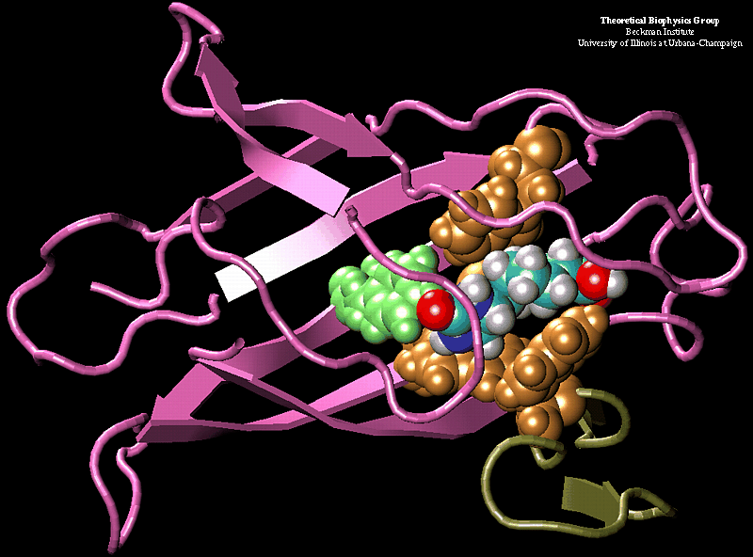
Scientific Visualization

Slide 21
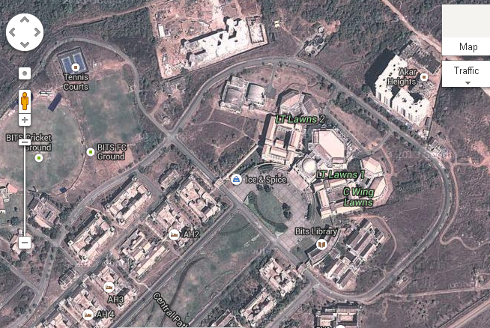
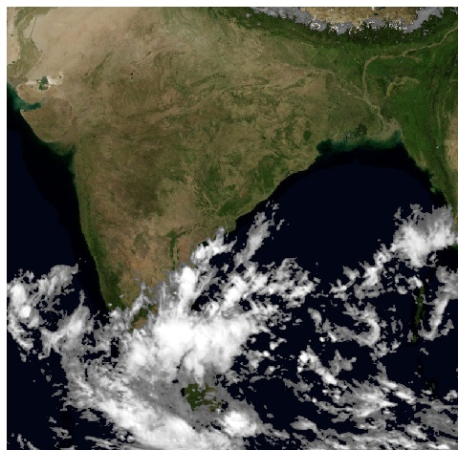
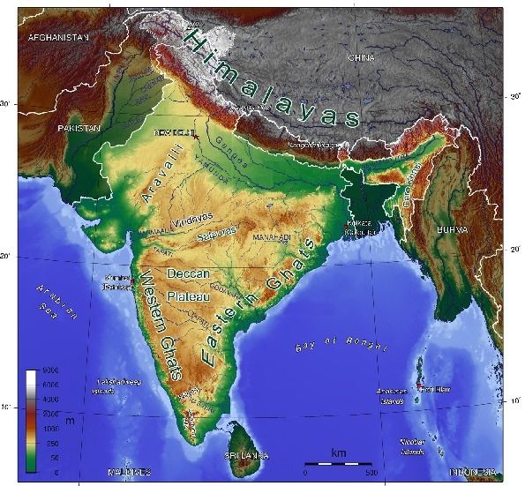
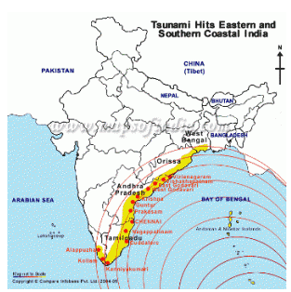
Cartography: Map making
Accurate and schematic representations of geographical and other natural phenomena from measured data
Geographic map
Relief map
Whether Map

Slide 22
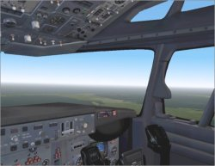
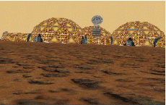
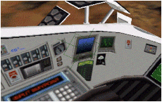
Simulation studies
Computer-Generated Models of Physical, Financial and Economic Systems for Educational Aids
Flight Simulator
Mars Rover Simulator

Slide 23
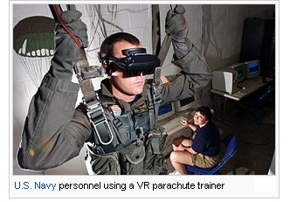
Virtual reality: Computer simulated environment

Slide 24

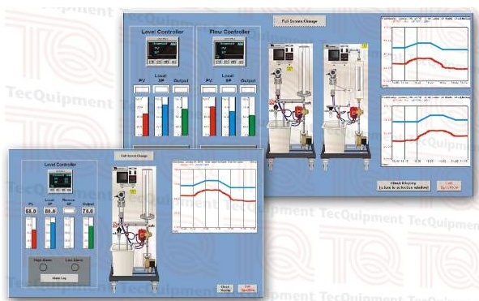
Process Monitoring

Slide 25
Multimedia
Audio + video + text + images
Image Processing
Manipulation, Storage, Editing, Enhancing, Removing noise from the image

Slide 26
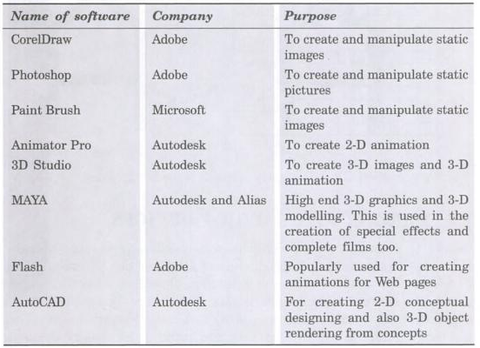
Graphical Software Packages

Slide 27
Standards available
Standards
Main motivation: device independent graphics packages
3D Core graphics: produced by an ACM’s SIGGRAPH (Special Interest Group in Graphics) in 1977 and refined in 1979
GKS: First graphics to be officially standardized
Adopted by ISO and ANSI
Restricted to only 2D
GKS-3D in 1988
Notes:
Association for Computing Machinery
GKS : Graphical Kernel System
SPHIGS – Simple PHIGS

Slide 28
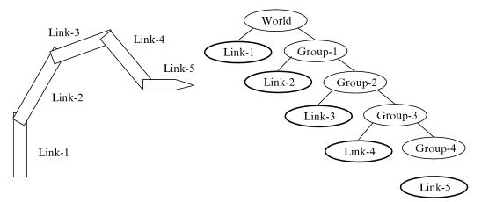
Contd…
PHIGS (Programmer’s Hierarchical Interactive Graphics System)
hierarchical object modeling
color specifications
surface rendering
picture manipulations

Slide 29
Contd…
SRGP ( Simple Raster Graphics Package):
Uses the features from
QuickDraw integer raster graphics package and MIT’s X window system for Output
GKS and PHIGS for Input
SPHIGS (Super Programmer’s Hierarchical Interactive Graphics System)
OpenGL (with ActiveX and Direct3D): device independent

Slide 30
On various platforms
DOS, Windows,
Linux, OS/2,
SGI(Silicon graphics Inc), SunOS,
Solaris, HP-UX(HP unix),
Mac, DEC-OSF(Digital equipment Corporation - Open S/W Foundation).
Notes:
HP-UX → HP unix
SGI: Silicon graphics Inc
DEC – OSF ->Digital equipment Corporation - Open S/W Foundation

Slide 31
More on CG…
Basic output primitives (or elements) for drawing pictures:
POLYLINE
Filled POLYGONS (regions)
ELLIPSE (ARC)
TEXT
Raster IMAGE

Slide 32
Important Terms
Image:
is an artifact usually two-dimensional has a similar appearance as that of an object
Image types
Two dimensional – ex: photograph
Three dimensional – ex: building
Images captured by optical devices – cameras
Digital image:
Is a representation of a two-dimensional image using ones and zeros

Slide 33
Important Terms
3. Pixel or Pel
Picture element
Is the smallest piece of information in an image
Usually arranged in a two dimensional grid and are often represented using dots or squares

Slide 34
Active and Passive Computer Graphics system
Based on the type of o/p generated
I/P to the system is the description of scene
Passive computer graphics system ➔ output is static
Active computer graphics system ➔ output is animated
User controls the display with the help of GUI, using an input device
Notes:
Ex: Passive system : movies
Active system : video games

Slide 35
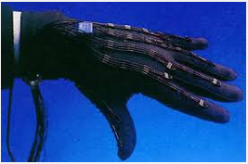
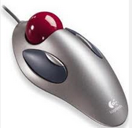
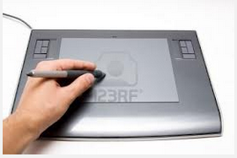
I/O devices
Input devices:
Keyboard
Mouse
Trackball and spaceball
Joysticks
Data glove
Graphical tablet or digitizer
Image scanners
Touch panels
Voice systems
Output devices
CRT EGA,CGA, VGA, SVGA monitors
Printers and plotters

Slide 36
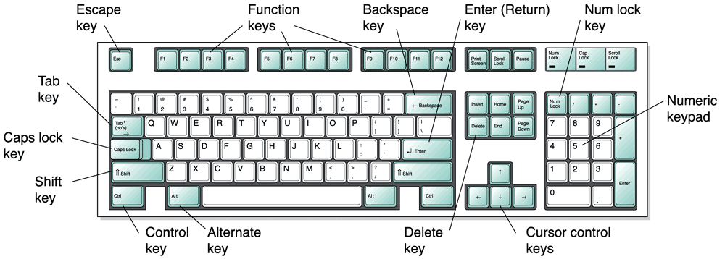
Input Devices
Keyboard
Scan Code
Keyboard buffer and keyboard controller

